Slide 1
DS-306 Data Warehousing and Business Intelligence
Topic 2: Overview of DW and BI
Dr. Khurram Shahzad

Slide 2
Operational Sources (OLTP’s)
Operational computer systems did provide information to run day-to-day operations, and answer’s daily questions, but…
Also, called online transactional processing system (OLTP)
Data is read or manipulated with each transaction
Transactions/queries are simple, and easy to write
Usually for middle management

Slide 3
Typical decision queries
Decision-making require complex questions from integrated data
Enterprise-wide data is desired
Decision makers want to know:
  Where to build new oil warehouse?
  Which market they should strengthen?
  Which customer groups are most profitable?
  How much is the total sale by month/ year/ quarter for each offices?
  Is there any relation between promotion campaigns and sales growth?
Can OLTP answer all such questions, efficiently?

Slide 4
Failure of old OLTPs
Inability to provide strategic information
IT receive too many ad hoc requests
Requests are not only numerous, they change overtime, because for more understanding more reports
Users are in spiral of reports
Users have to depend on IT for information
Can't provide enough performance, slow
Strategic information have to be flexible and conductive, analysis driven (not report driven analysis)

Slide 5
Expectations of new soln.
DB designed for analytical tasks
Data from multiple applications
Easy to use
Ability of what-if analysis, (analysis driven)
Read-intensive data usage
Direct interaction with system, without IT assistance
Periodical updating contents & stable
Current & historical data
Ability for users to initiate reports

Slide 6
DW meets expectations
Provides enterprise view
Current & historical data available
Decision-transaction possible without affecting (locking) operational source
Reliable source of information
Ability for users to initiate reports
Acts as a data source for all analytical applications

Slide 7
OLTP vs. BI
Trait | OLTP | BI
User | Middle management | Executives, decision-makers
Function | For day-to-day operations | For analysis & decision support
DB (modeling) | E-R based, after normalization | Star oriented schemas
Data | Current, Isolated | Archived, derived, summarized
Unit of work | Transactions | Complex query
Access, type | DML, read | Read
Access frequency | Very high | Medium to Low
Records accessed | Tens to Hundreds | Thousands to Millions
Quantity of users | Thousands | Very small amount
Usage | Predictable, repetitive | Ad hoc, random, heuristic
DB size | 100 MB-GB | 100GB-TB
Response time | Sub-seconds | Up-to min.

Slide 8
Architecture of BI solution

Slide 9
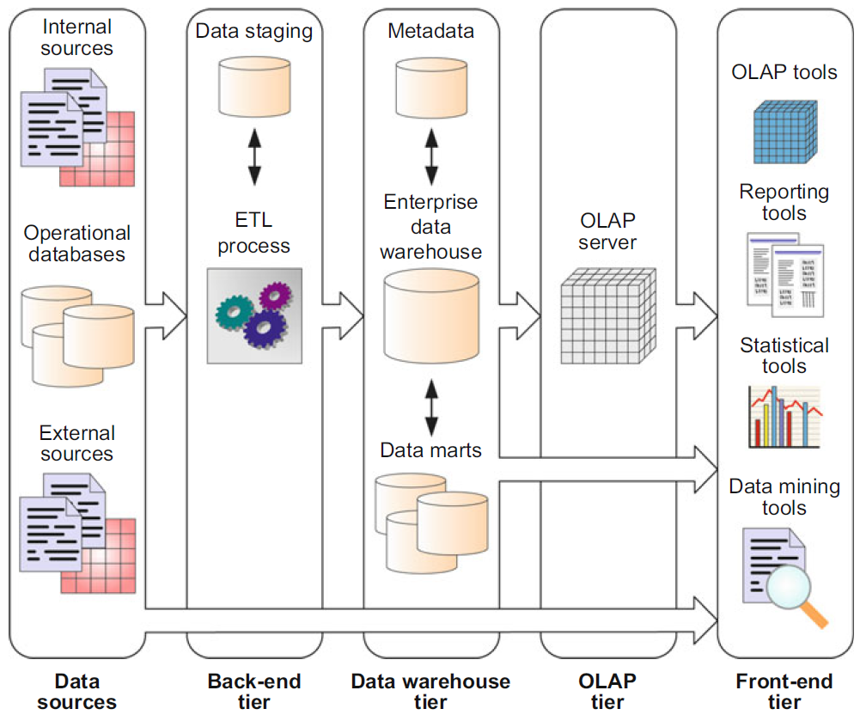
Typical DW architecture

Slide 10
1. Data Sources
Source data can be grouped into 4 components
  Production data
    Comes from operational systems of enterprise
    Some segments are selected from it
    Narrow scope, e.g. order details
  Internal data
    Private datasheet, documents, customer profiles etc.
    E.g. Customer profiles for specific offering
    Special strategies to transform ‘IT’ to DW (text document)
  Archived data
    Old data is archived
    DW have snapshots of historical data
  External data
    Executives depend upon external sources
    E.g. market data of competitors, car rental require new manufacturing. Define conversion

Slide 11
Typical DW architecture

Slide 12
2. Back-end Tier
After data is extracted, data is to be prepared
Data extracted from sources needs to be changed, converted and made ready in suitable format
Three major functions to make data ready
  Extract
  Transform
  Load
Staging area provides a place and area with a set of functions to
  Clean
  Change
  Combine
  Convert

Slide 13
Typical DW architecture

Slide 14
3. Data Warehouse Tier
Separate repository
Data structured for efficient processing
Redundancy is increased
Updated after specific periods
Only read-only

Slide 15
Typical DW architecture

Slide 16
4. Information Delivery Component
Authentication issues
Active monitoring services
  Performance
  User performance
  Aggregate awareness
  E.g. mining, OLAP etc

Slide 17
Definition of DW

Slide 18
Data Warehouse
A data warehouse is a particular database targeted toward decision support.
It takes data from various operational databases and other data sources and transforms it into new structures that fit better for the task of performing business analysis.
DWs are based on a multidimensional model, where data are represented as dimensions corresponding to the various business perspectives and cube cells containing the measures to be analyzed.

Slide 19
Definition of DW
Inmon defined
“A DW is a subject-oriented, integrated, non-volatile, time-variant collection of data in favor of decision-making”.
Kelly said
“Separate available, integrated, time-stamped, subject-oriented, non-volatile, accessible”
  Four properties of DW

Slide 20
Subject-oriented
In operational sources data is organized by applications, or business processes.
In DW, subject is the organization method
Subjects vary with enterprise
These are critical factors, that affect performance
Example of Manufacturing Company
  Sales
  Shipment
  Inventory, etc.

Slide 21
Integrated Data
Data comes from several applications
Problems of integration comes into play
  File layout, encoding, field names, systems, schema, data heterogeneity are the issues
  Bank example, variance: naming convention, attributes for data item, account no, account type, size, currency
In addition to internal, external data sources
  External companies data sharing
  Websites
  Others
Removal of inconsistency
So process of extraction, transformation & loading

Slide 22
Time variant
Operational data has current values
Comparative analysis is one of the best techniques for business performance evaluation
Time is critical factor for comparative analysis
Every data structure in DW contains time element
In order to promote certain products, analyst has to know about current and historical values
The advantages are
  Allows for analysis of the past
  Relates information to the present
  Enables forecasts for the future

Slide 23
Non-volatile
Data from operational systems are moved into DW after specific intervals
Data is persistent/ not removed i.e. non volatile
Every business transaction don’t update in DW
Data from DW is not deleted
Data is neither changed by individual transactions
Properties summary
Subject Oriented
Time-Variant
Non-Volatile
Organized along the lines of the subjects of the corporation. Typical subjects are customer, product, vendor and transaction.
Every record in the data warehouse has some form of time variancy attached to it.
Refers to the inability of data to be updated. Every record in the data warehouse is time stamped in one form or another.

Slide 24
Multidimensional Model

Slide 25
Typical DW architecture

Slide 26
Dimensional Model
Data warehouses and OLAP systems are based on multidimensional model
Dimensional modeling focuses subject-orientation, critical factors of business
Critical factors are stored in facts

Slide 27
Dimensional Model
Logical design technique for high performance
Each model represent a subject in DW
Is the modeling technique for storage

Slide 28
Dimensional Model
Two important concepts
  Fact
    Numeric measurements, represent business activity/event
    Are pre-computed, redundant
    Example: Profit, quantity sold
  Dimension
    Qualifying characteristics, perspective to a fact
    Example: date (Date, month, quarter, year), product(type, category)

Slide 29
Dimensional Model
Every dimensional model (DM) is composed of one (or more) fact tables, and a set of smaller dimension tables.
Look on Fact table through one (or more) dimensions.
  What is the sale amount in Consumer Product category, for elderly customers in the second quarter of 2004?
Forms ‘star-like’ structure, which is called a star schema or star join.

Slide 30
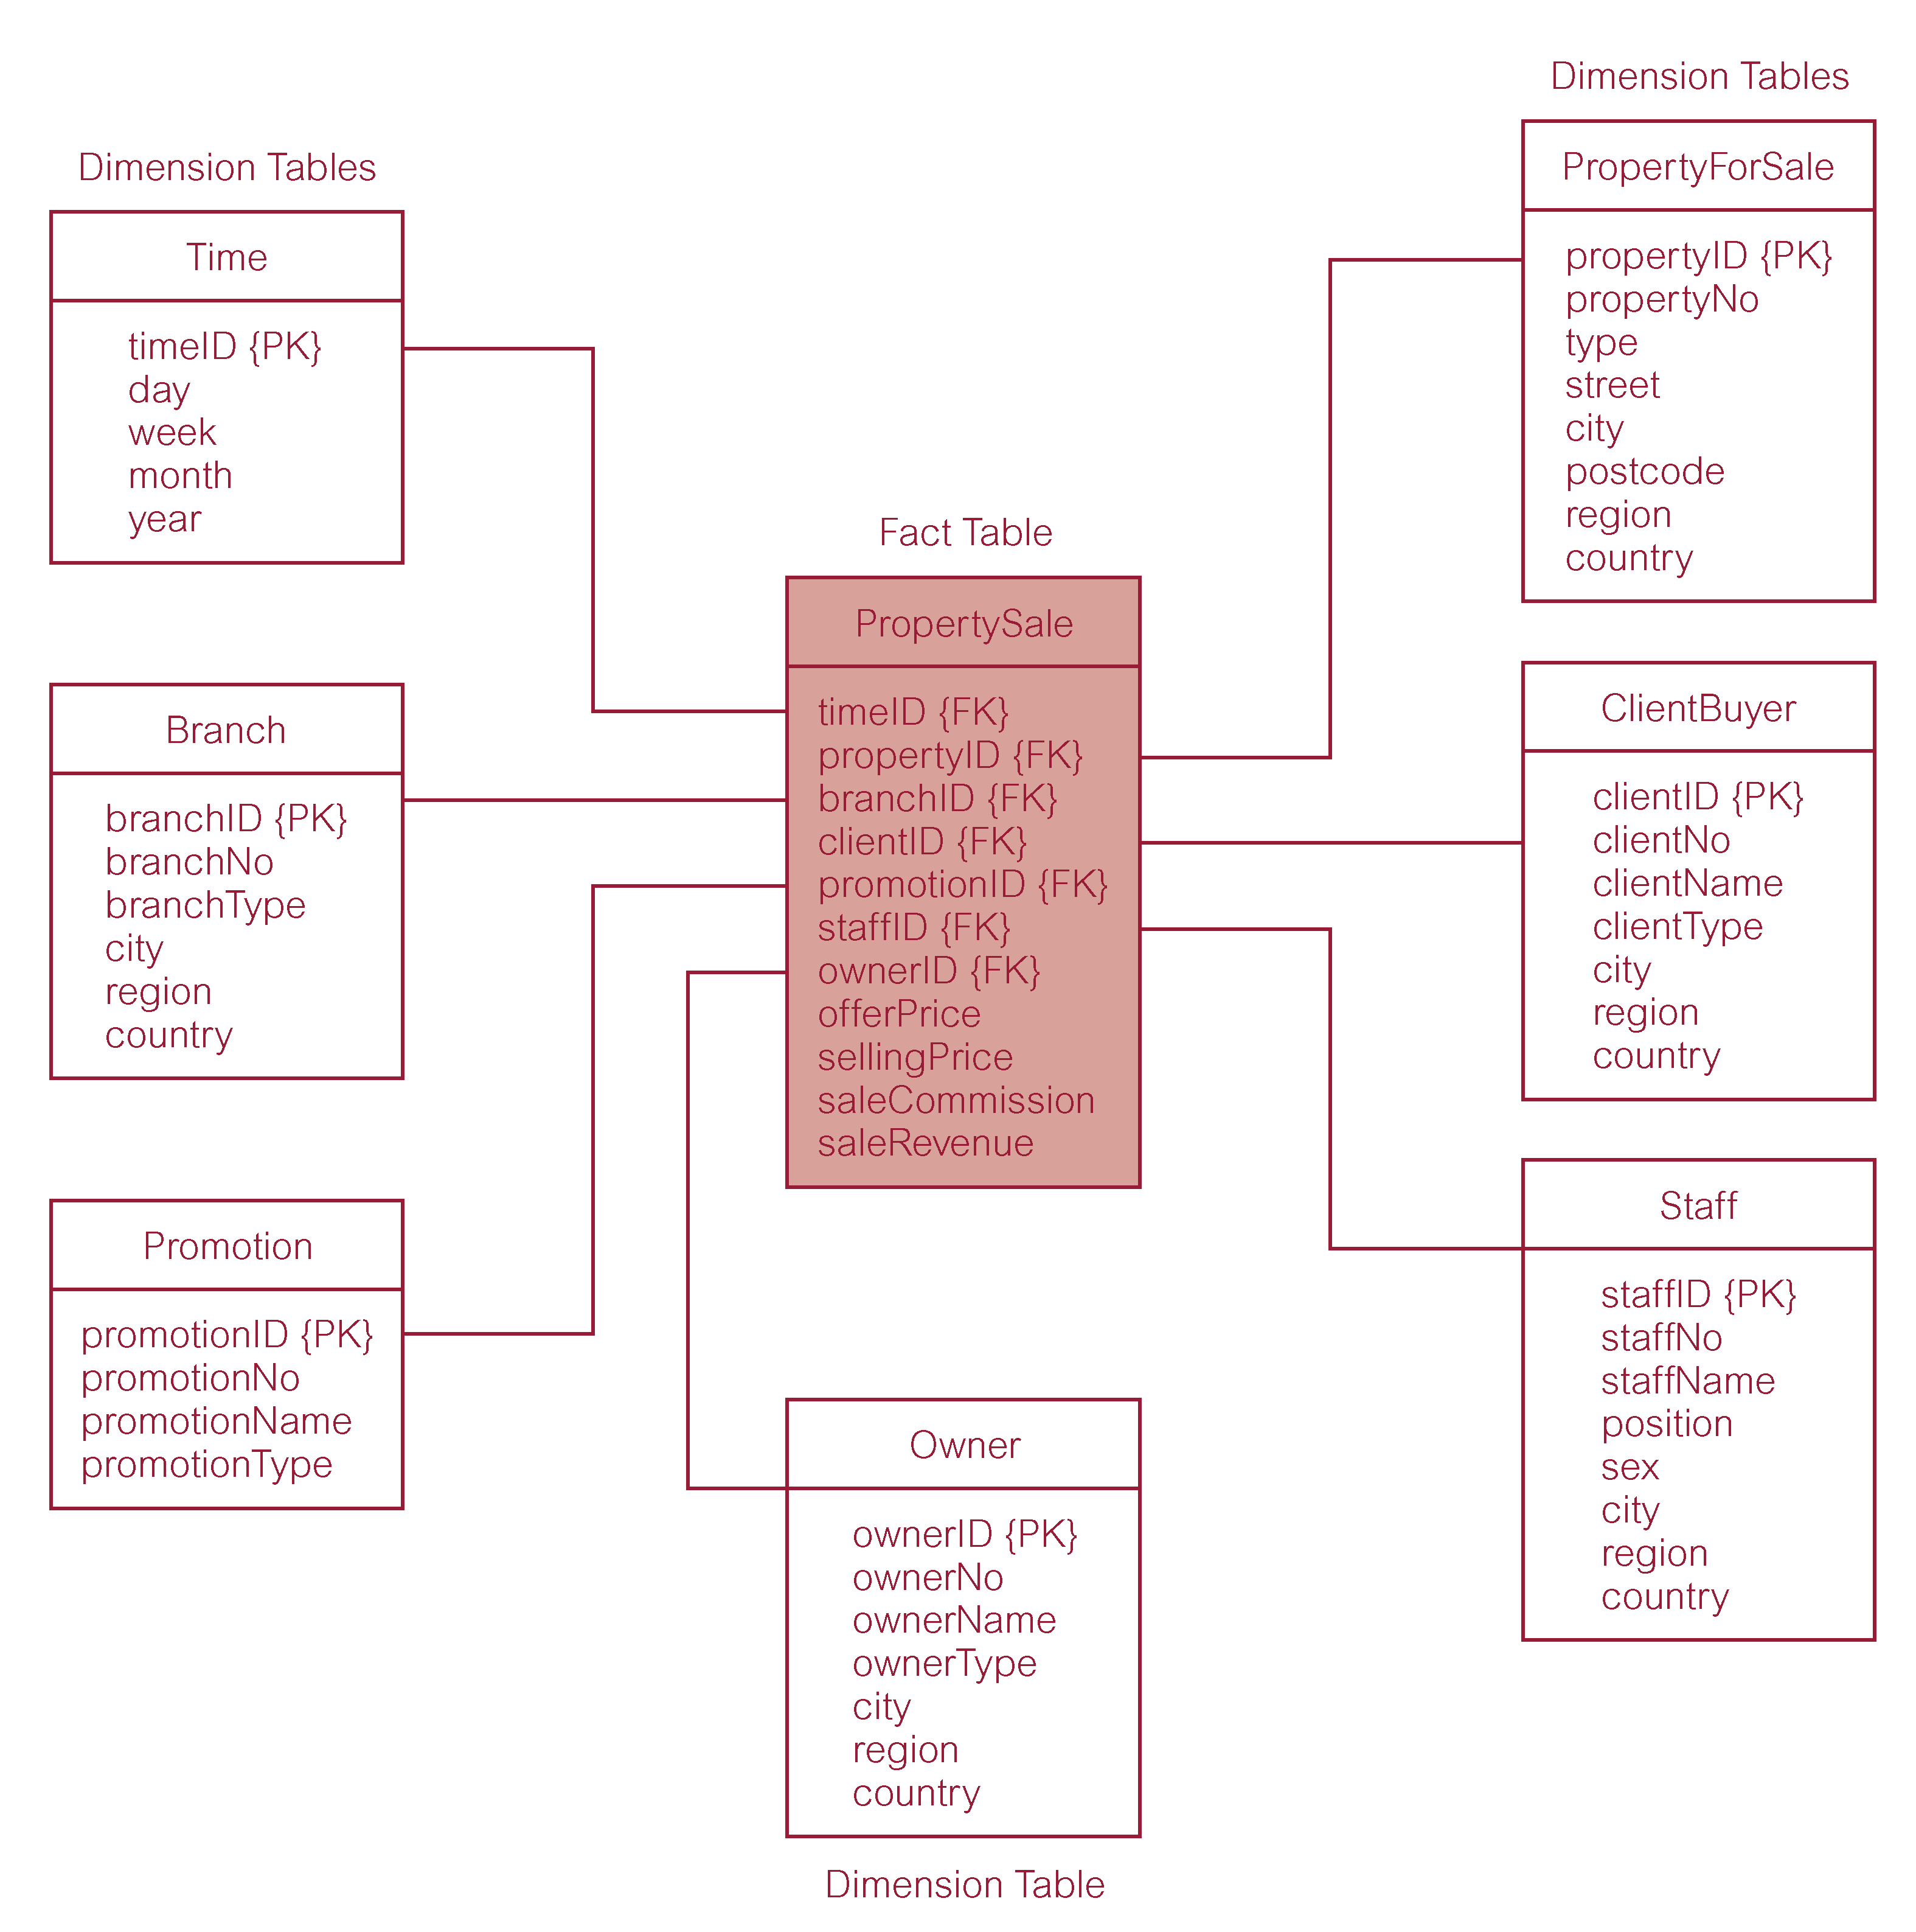
A Typical Dimensional Model

Slide 31
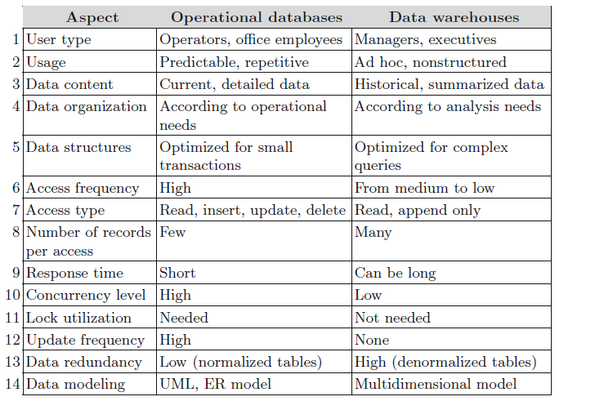
Operational DB vs DW

Slide 32
OLAP

Slide 33
Typical DW architecture

Slide 34
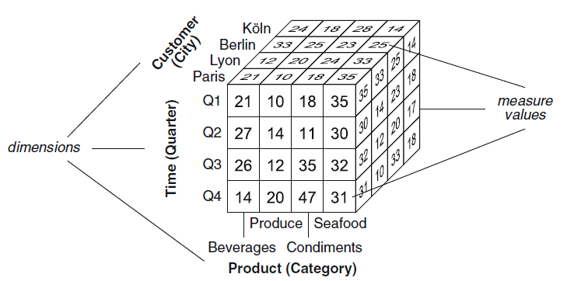
Data Cube
A data cube is defined by dimensions and facts

Slide 35
Cube
The cube has three dimensions
  Product
  Time
  Customer city
The cells of a data cube, or facts, have associated numeric values

Slide 36
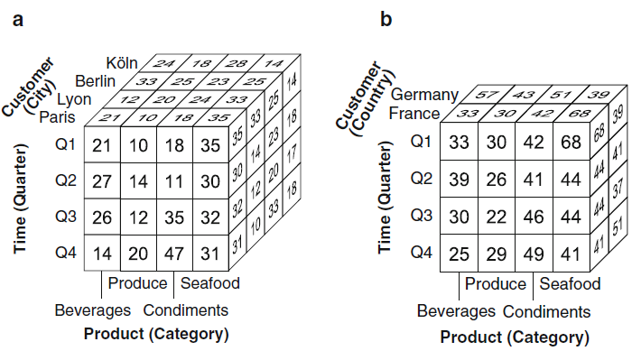
OLAP Operations

Slide 37
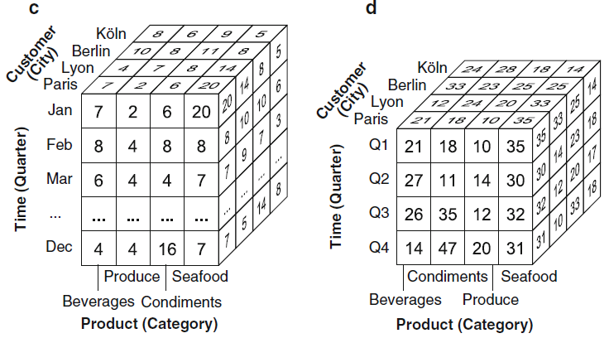
OLAP Operations

Slide 38
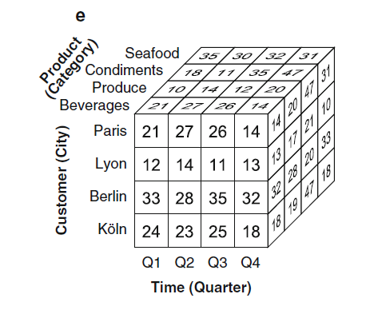
OLAP Operations

Slide 39
Business Intelligence Tools

Slide 40
BI tools
Microsoft
Oracle
IBM
Teradata
SAP
Microstrategy
Targit

Slide 41
Microsoft SQL Server tools
Database Engine
Integration services (SSIS)
Analysis Services & Reporting Services

